Slide 1
Airbus - Fly Your Ideas
Proposed design of an eco-efficient air-conditioning system

Slide 2
Introduction to Aircraft A/C
Aircraft air-conditioning (A/C) systems provide the following:
Fresh air supply – human health requirements
Pressurisation for cabin (important to note that cabin not sealed – 50% air recycled, and 50% extract, extract air rate determines pressure in cabin)
Heating – air bled from compressor , this is at a high enough pressure and temperature to cover all heating requirements
Cooling – this is the most power consuming aspect of the air conditioning system, heat exchangers and turbines play a key role in reducing the temperature and pressure of the supply air. The refrigeration cycle is where efficiency can be improved

Slide 3
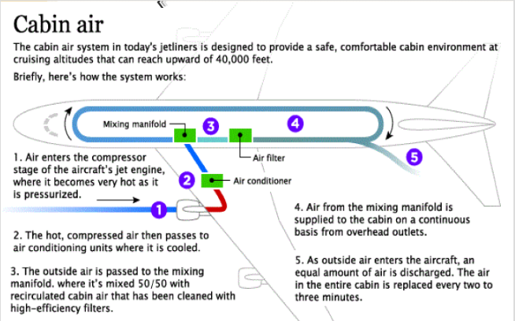
Modern Aircraft A/C System

Slide 4
How Air Enters the Cabin

Slide 5
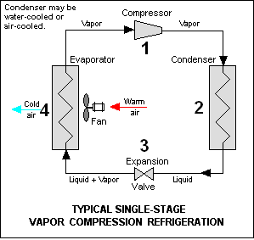
Vapour Refrigeration Cycle
A/C refrigeration systems are based on vapour cycle process
1 – Refrigerant enters compressor >press & >temp
2 - Refrigerant condenses – latent heat released, <temp, vapour to liquid
3 – Refrigerant enters expander, <temp & <press
4 - Refrigerant absorbs heat, >temp, liquid evaporates

Slide 6
Air Refrigeration Cycle
Aircrafts A/C systems utilise the closed vapour cycle process however instead of using a refrigerant they use air and create an open cycle (supply and extract).
There have been three main developments of A/C refrigerant systems in recent years
Starting with:
Basic Air Cycle Refrigeration Process
Bootstep Air Cycle Refrigeration Process
Three Wheel Air Cycle Refrigeration Process
BIRDS Eco-efficient Air Cycle Refrigeration Process

Slide 7
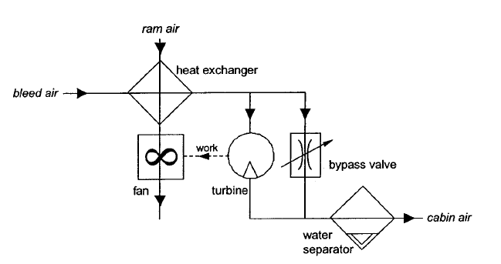
Basic Air Refrigeration Cycle
Advantages:
-Turbine used to expand and regulate pressure for cabin
-Kinetic energy created from turbine harnessed and used to rotate fan which drives the ram air through the heat exchanger

Slide 8
Bootstrap Refrigeration Air Cycle
Advantages over Basic Cycle:
-Kinetic energy in turbine used to drive compressor instead
-This increases the pressure of air supplied to turbine
-Greater pressure drop across turbine improves performance and hence efficiency.

Slide 9
Bootstrap Refrigeration Cycle adopted in Boeing 727

Slide 10
Three-Wheeled Refrigeration Air Cycle
Advantages over Basic Cycle:
-Kinetic energy in turbine used to drive both a compressor and fan
-High pressure water separator installed behind turbine
-This results in higher temperature difference at the heat exchanger and hence higher efficiency

Slide 11
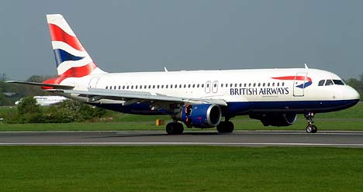
Airbus A320 currently uses a three wheel refrigeration cycle

Slide 12
Team BIRDS Refrigeration Cycle
To develop a more efficient open air refrigeration cycle system

Slide 13
Idea Criteria Assessment
Following the further research, I reviewed the idea against the following criteria
Originality
Complexity
Group subject knowledge
Supervisor subject knowledge
Level of economic benefit
Level of environment benefit
Industry desirability
Experimental Potential
Cost of project

Slide 14
Originality
Improving the efficiency of aircraft refrigeration cycle systems is an idea that is fairly common amongst aircraft manufacturers
The concept of improving the efficiency is unoriginal however the method by which we achieve it is where originality can be gained.
For originality
We could not simply utilise the turbine energy for an alternative purpose
We would have to analyse the whole thermodynamic cycle (possibly ditch Brayton in order to achieve more originality)

Slide 15
Complexity
The concept of the thermodynamic cycle involved in the refrigeration process is not complex
If we were to take this project forward, we would be required to analyse the full thermodynamic cycle in cycle in order to determine whether improved efficiency can be truly gained. This would require detailed investigation into the following process:
Turbine
Compressor
Water separator
Heat exchangers
Possible sections could be divided amongst group with each person specialising in a particular process

Slide 16
Group Subject Knowledge
Looking at the surface, air conditioning systems might seem to stray from overall group knowledge however hopefully the what has been detailed will clear this up.
More involved with familiar topics and devices
Turbines, compressors, heat exchangers familiar
Thermodynamic cycles, Brayton cycles etc.
Although the foundations to the idea are well-known, there is still the potential for a great deal of learning +work.
Bringing together knowledge of various systems

Slide 17
Supervisor Subject Knowledge
Hard to say how much Sticky knows about air conditioning
He did mention the idea of investigating air conditioning systems
Think for any lecturer specialising in aerodynamics will know some degree of air conditioning in aircrafts
How significant is this criteria?

Slide 18
Economic Benefit
Airbus spend a significant amount of money in developing aircraft A/C systems
A/C is the second most power consuming aircraft device, after propulsion, so any small improvement in efficiency will result in a noticeable economic benefit.
Not just about A/C efficiency, reducing weight of A/C devices and components or its dependency on aircraft propulsion turbines will have a positive impact on economy

Slide 19
Environmental Benefit
There are many possible environmental benefits that can results from this idea:
Reduced power consumption per flight
Reduced carbon emissions
Reduced fuel consumption
Improved turbine fuel performance
Improved air quality and cabin comfort
The level of environmental benefit will depend upon the exact idea after conducting a thorough investigation.

Slide 20
Industry Desirability
Whether this project succeeds in the Airbus competition will be dependant upon developing an detailed idea plan
Simply stating that we are going to improve aircraft A/C efficiency will be too vague and I believe will not be sufficient enough to progress to round 2
Will require, the group to spend next week working together on this topic to developed a more detailed strategy that will have some reference to a thermodynamic process.

Slide 21
Experimental Potential
In terms of practical experiments, its unlikely we will be able to get some turbines, compressor and heat exchangers.
This project seems to be mainly theoretical however I believe that we can incorporate and develop MATLAB and Simulink into project
Construct our improved thermodynamic cycle that will piece together each persons specialisms (turbines, compressors and heat exchangers)
This would be a dynamic energy model that would have a certain degree of realism
Resulting product would be a program that would emulate the refrigeration cycle process.

Slide 22
Cost of Project
Having no practical experimental potential negates any requirement for specialist equipment.
Possible student licenses for MATLAB and Simulink (£80 per person approx.)
Field trip??????

Slide 23
Summary
Criteria | Comments
Originality | Recognised sector with good innovate potential
Complexity | Could get quite complex, challenging though
Group Subject Knowledge | More than enough, tasks divided into specialities
Supervisors Subject Knowledge | To a certain degree, how relevant?
Economic Benefit | Excellent
Environmental Benefit | Number of potential benefits
Experimental Procedure | MATLAB and Simulink model
Industry Desirability | Requires more detailed developed and specific direction
Cost of Project | We have enough

Slide 24
Conclusion
Decent project idea with good potential for success
Will require a considerable form of development of the next few weeks to narrow down the scope and exact strategy
I am interested in the subject, intrigued to find out more
I admire the idea of each person having their own specialism, turbines, compressor, HE. Would end up bringing together everyones ideas in the development of a MATLAB model to determine and verfiy systems success at improving A/C efficiency.
I would be happy with this as our project, would do you guys think?

Slide 25
The End

