Slide 1
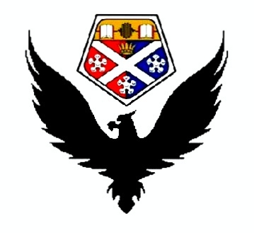
BIRDS
Shortlist for the FYI:
Air Conditioning;
Boundary Layer Control;
Kinetic Pumps;
Riblets;
Turnaround Time.
Group L:
Adnan Mahmood
David Dunsmore
Jonathan Strachan
Matheus Moschetta
Robert Adam
Supervisor: Dr Matthew Stickland

Slide 2
BIRDS
Boundary Layer Control
Boundary Layer Control (BCL) is the control of the flow of air over a body by imparting controlled periodic motion to it. The performance of an aircraft is restricted by the separation of the boundary layer at the top surface of the wings.
This flow separation causes enormous decrease in lift, leading to stalling the aircraft. The flow separation drastically increases the drag forces also.
Performance of an aircraft can be significantly enhanced by preventing this flow separation. Many methods, e.g., shaping, wall cooling, turbulators (vortex generators), boundary layer acceleration andtranspiration (suction) have been tried over the years to prevent this effect.

Slide 3
BIRDS
Shaping:
Transition from laminar to turbulent flow can be delayed with the use of suitably designed airfoils which relegate the point of transition further downstream thus reducing the total frictional drag of the body.
Depending on the Reynolds number, the airfoil shape, the surface roughness and the incidence angle, the boundary layer beyond the minimum pressupre point either becomes turbulent shortly after or it temporarily dettaches forming separation bubbles.

Slide 4
BIRDS
Wall Cooling:
An increase in air temperature will result in na increase of its viscosity. Therefore, the removal of heat from the body surface causes na increase of the velocity gradient on the wall which produces a more full and stable profile.

Slide 5
BIRDS
Turbulators (Vortex Generators):
A turbulent boundary layer is more resistant to separation and therefore transition may be desirable in lifting devices to avoid stall. Transition can be advanced by exposing the boundary layer to large disturbances by placing singles, multiple or distributed roughness elements on the wall.
Is is important for the turbulator to suppress laminar separation without making the boundary layer unnecessarily thick, since thick turbulent boundary layers are more prone to separation than thin ones.
Vortex generators also can be used for the energy enrichment of the near wall flow, by creating a tip vortex which draws air from the outer flow regions into the boundary layer. They are tipically rectangular or triangular, with a height comparable to the boundary layer thickness, and are positioned near the leading edge, upstream of where laminar separation is expected.

Slide 6
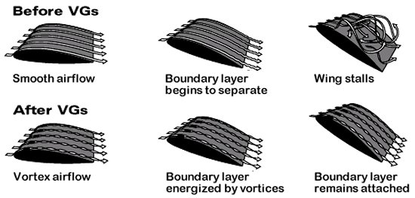
BIRDS
Vortex generators work by mixing high-energy air from the free stream with the lower energy air found in the boundary layer. The lift can be increased by about 10% and drag reduced by about 50%.
It has been show in the literature that if the vortex generators are operated periodically at moderate frequencies, the process of flow reattachment is more efficient and has a wider range of application.
Vortex Generators

Slide 7
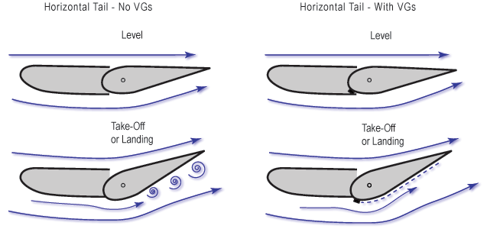
BIRDS
Many aircraft carry vane vortex generators from time of manufacture, but there are also after-market suppliers who sell VG kits to improve the STOL performance of some light aircraft. After-market suppliers claim that VG’s lower stall speed and reduce take-off and landing speeds, and that VG’s increase the effectiveness of ailerons, elevators and rudders, thereby improving controllability and safety at low speeds.
Vortex Generators

Slide 8
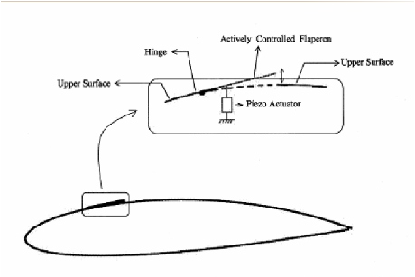
BIRDS
Using a mechanism of an oscillating plate vortex generator an oscillatory momentum addition can be provided to the retarded flow in the boundary layer and the separation of the flow from the top surface of the airfoil can be delayed. This will lead to na increase in the lift and a possible decrease in the pitching moment.
Schematic of the actuation scheme

Slide 9
BIRDS
Boundary Layer Acceleration:
By supplying additional energy to the retarded fluid particles near the surface and thus modifying the velocity profile, it is possible to delay separation until larger angles of attack. This can be achieved either by discharge of fluid from within the airfoil or through the implementation of a slat in the leading edge.

Slide 10
BIRDS
Transpiration (Suction):
Another method to avoid separation is by changing the curvature of the velocity profile via the withdrawal of the near wall fluid through slots or porous surfaces. The effect of suction consists of the removal of the retarded fluid particles located at the region close to the surface thus preventing the reversal of the flow. The resulting boundary layer is much thinner and more capable of overcoming the adverse pressure gradient, allowing the flow to progress further downstream the surface wall without separating.
The implementation of suction techniques allows the suppression of separation at higher angles of attack, thus achieving high lift coefficients. In addition, suction can result in the shifting of the transition point further downstream thus reducing frictional drag, since an extended laminar region implies smaller shear on the surface.

Slide 11
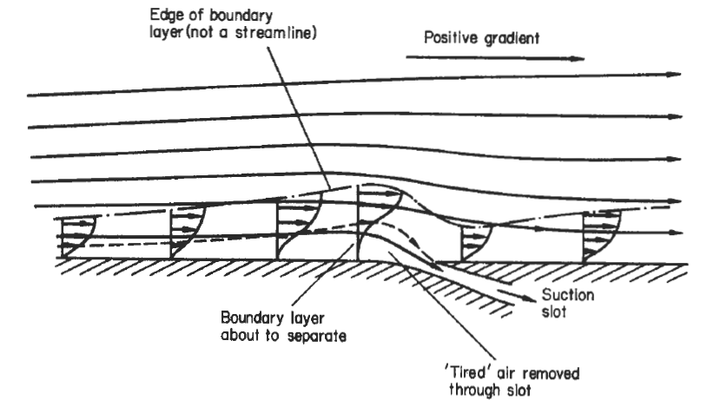
BIRDS
The kinetic energy of the fluid layers adjacent to the surface can be increased by removing low energy air through suction slots or a porous surface. Suction suspends boundary layer growth and leads to a fuller velocity profile. It can therefore be used to delay transition, postpone separation or relaminarize an already turbulent flow. By changing the curvature of the velocity profile at the wall the stability characteristics of the flow can be enhanced, thus preventing the critical Reynolds number.
Boundary layer control via suction

Slide 12
BIRDS
Boundary Layer Control with Riblets:
Considerable efforts have been devoted to the study of the riblets in a turbulent boundary layer. It has been well established that relative to the smooth wall boundary layer, riblets can reduce the frictional drag of a turbulent boundary layer.
The influence of the riblets surface on the near-wall turbulence structure differs, according to wheter the riblets reduce or increase the skin-frictional drag relative to a smooth wall. While the Reynolds stress tensor over drag-reducing riblets is only marginally different from that on a smooth wall, the Reynolds stresses under drag-augmenting conditions are larger and the flow is more isotropic than on a smooth wall.
Turbulent drag reduction experienced by ribletted surfaces is the result of both the interaction between riblet peaks and the coherent structures that characterize turbulent near-wall flows, and the laminar sublayer flow modifications caused by the riblet shape, which can balance, under appropriate conditions, the drag penalty due to the increased wetted surface.
Riblet effectiveness is clearly shown to be related to the difference between the longitudinal and the transversal protrusion heights.

